Slide 1
Assignment 5
Part 3

Slide 2
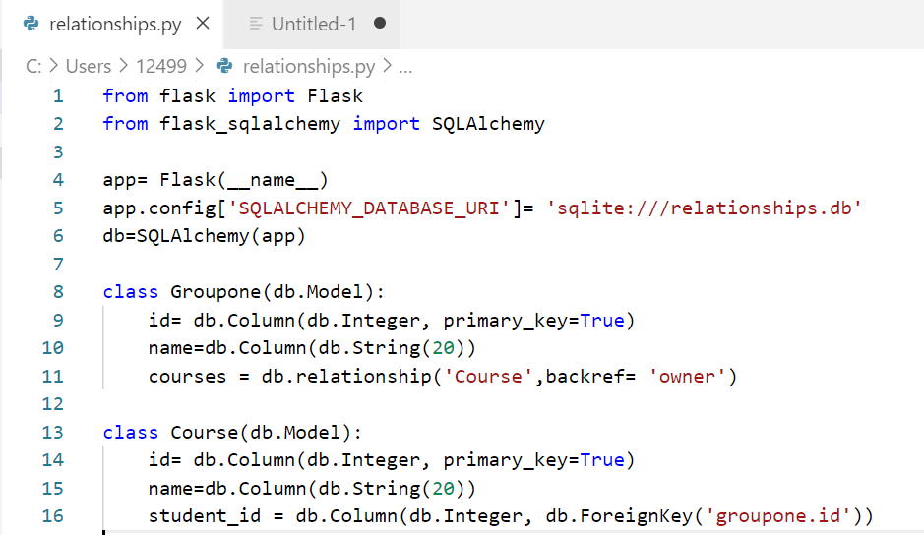
Code to create the database and table structure

Slide 3
Adding the table structure onto the database
In the Anaconda Prompt - python >>> db_createall() >>> from relationships import db
The create all statements creates the tables in the ‘relationship’ database
In the above statement “relationships” is the name of python file that is saved in the current directory and invokes the database to perform operations on it.

Slide 4
Adding the data to the database
>>> Mehul = Groupone(name='Mehul')
>>> db.session.add(Mehul)
>>> db.session.commit()
>>> Tanaaz = Groupone(name='Tanaaz')
>>> db.session.add(Tanaaz)
>>> db.session.commit()
>>> BDAT = Course(name='BDAT', owner=Mehul)
>>> db.session.add(BDAT)
>>> db.session.commit()
>>> Hospitality = Course(name='Hospitality', owner=Tanaaz)
>>> db.session.add(Hospitality)
>>> db.session.commit()
>>> ProjectManagement = Course(name='ProjectManagement',owner=Mehul)
>>> db.session.add(ProjectManagement)
>>> db.session.commit()

Slide 5
Viewing the data
>>> Mehul.courses
[<Course 1>, <Course 3>]
>>> Tanaaz.courses
[<Course 2>]

Slide 6
One to Many Relationships
Here, one students can be enrolled to one or more courses and that has been linked using the foreign keys, and using the relationship function.

